Slide 1

WELCOME
Project by :-
Prathamesh Anand Patole(12001)
Govinda Kishor N(12054)
Topic :- Uber Data Analysis Using Data Visualization

Slide 2
INDEX
Sr No. | Content
1 | INTRODUCTION
2 | INTRODUCTION TO R LANGUAGE
3 | ABOUT DATA AND GRAPHS
4 | DATA PREPROCESSING
5 | PACKAGES/LIBRARIES USED
6 | BASIC COMMANDS OF R
7 | DATA VISUALIZATION
8 | SUMMARY
9 | REFERENCES

Slide 3
INTRODUCTION
Data storytelling is an important component of Machine Learning through which companies are able to understand the background of various operations. With the help of visualization, companies can avail the benefit of understanding the complex data and gain insights that would help them to craft decisions. In this project we are going to analyze the data of Uber company. We will be using R commands to generate different graphs. Hope you will enjoy the project!!!

Slide 4
INTRODUCTION TO R LANGUAGE
R is a programming language for statistical computing and graphics supported by the R Core Team and the R Foundation for Statistical Computing. Created by statisticians Ross Ihaka and Robert Gentleman, R is used among data miners and statisticians for data analysis and developing statistical software. Users have created packages to augment the functions of the R language.
Polls, data mining surveys, and studies of scholarly literature databases show that R is highly popular; since January 2022, R ranks 12th in the TIOBE index, a measure of programming language popularity.
The official R software environment is an open-source free software environment within the GNU package, available under the GNU General Public License. It is written primarily in C, Fortran, and R itself (partially self-hosting). Precompiled executables are provided for various operating systems. R has a command line interface. Multiple third-party graphical user interfaces are also available, such as RStudio, an integrated development environment, and Jupyter, a notebook interface.

Slide 5
ABOUT DATA AND GRAPHS
In this project, we will analyze the Uber Pickups in New York City dataset. In which there is details of each and every pickups of Uber in New York city on specific months of 2014. Using R commands we will be generating graphs through which we can easily analyze the data. We will be using Bar Graph, Heat Map and Ride based map for our analysis.
Bar Graph:- Bar chart or bar graph is a chart or graph that presents categorical data with rectangular bars with heights or lengths proportional to the values that they represent. A bar graph shows comparisons among discrete categories.
Heat Map:- A heat map or choropleth map is a data visualization that shows the relationship between two measures and provides rating information. The rating information is displayed using varying colors or saturation and can exhibit ratings such as high to low or bad to awesome, and needs improvement to working well. It can also be a thematic map in which the area inside recognized boundaries is shaded in proportion to the data being represented.
Ride based map:- This is overall map of the city based on Uber ride. It will show the pickup points in city based on latitude and the longitude of the location.

Slide 6
DATA PREPROCESSING
Data Cleaning:
The data can have many irrelevant and missing parts. To handle this part, data cleaning is done. It involves handling of missing data, noisy data etc.
Noisy Data: Noisy data is a meaningless data that can’t be interpreted by machines. It can be generated due to faulty data collection, data entry errors etc.
Clustering: This approach groups the similar data in a cluster. The outliers may be undetected or it will fall outside the clusters. We used clustering method to eliminate the noisy data or error data. And we used processed data for our analysis.

Slide 7
PACKAGES/LIBRARIES USED
In the first step of our project, we will import the essential packages that we will use in this uber data analysis project. Some of the important libraries of R that we will use are –
ggplot2
This is the backbone of this project. ggplot2 is the most popular data visualization library that is most widely used for creating aesthetic visualization plots.
ggthemes
This is more of an add-on to our main ggplot2 library. With this, we can create better create extra themes and scales with the mainstream ggplot2 package.
Lubridate
Our dataset involves various time-frames. In order to understand our data in separate time categories, we will make use of the lubridate package.
dplyr
This package is the lingua franca of data manipulation in R.
tidyr
This package will help you to tidy your data. The basic principle of tidyr is to tidy the columns where each variable is present in a column, each observation is represented by a row and each value depicts a cell.
DT
With the help of this package, we will be able to interface with the JavaScript Library called – Data tables.
scales
With the help of graphical scales, we can automatically map the data to the correct scales with well-placed axes and legends.

Slide 8
BASIC COMMANDS OF R
Commands to install libraries :-
library(ggplot2)
library(ggthemes)
library(lubridate)
library(dplyr)
library(tidyr)
library(DT)
library(scales)

Slide 9
Create a vector of our colors
colors = c("#CC1011", "#665555", "#05a399", "#cfcaca", "#f5e840", "#0683c9", "#e075b0")
Formatting of Date
apr_data <- read.csv("D:/DEAP Project/Uber-dataset/uber-raw-data-apr14.csv")
may_data <- read.csv("D:/DEAP Project/Uber-dataset/uber-raw-data-may14.csv")
jun_data <- read.csv("D:/DEAP Project/Uber-dataset/uber-raw-data-jun14.csv")
jul_data <- read.csv("D:/DEAP Project/Uber-dataset/uber-raw-data-jul14.csv")
aug_data <- read.csv("D:/DEAP Project/Uber-dataset/uber-raw-data-aug14.csv")
sep_data <- read.csv("D:/DEAP Project/Uber-dataset/uber-raw-data-sep14.csv")
data_2014 <- rbind(apr_data,may_data, jun_data, jul_data, aug_data, sep_data)
data_2014$Date.Time <- as.POSIXct(data_2014$Date.Time, format = "%m/%d/%Y %H:%M:%S")
data_2014$Time <- format(as.POSIXct(data_2014$Date.Time, format = "%m/%d/%Y %H:%M:%S"), format="%H:%M:%S")
data_2014$Date.Time <- ymd_hms(data_2014$Date.Time)
data_2014$day <- factor(day(data_2014$Date.Time))
data_2014$month <- factor(month(data_2014$Date.Time, label = TRUE))
data_2014$year <- factor(year(data_2014$Date.Time))
data_2014$dayofweek <- factor(wday(data_2014$Date.Time, label = TRUE))
data_2014$hour <- factor(hour(hms(data_2014$Time)))
data_2014$minute <- factor(minute(hms(data_2014$Time)))
data_2014$second <- factor(second(hms(data_2014$Time)))
These commands will arrange the data and time in standard format

Slide 10
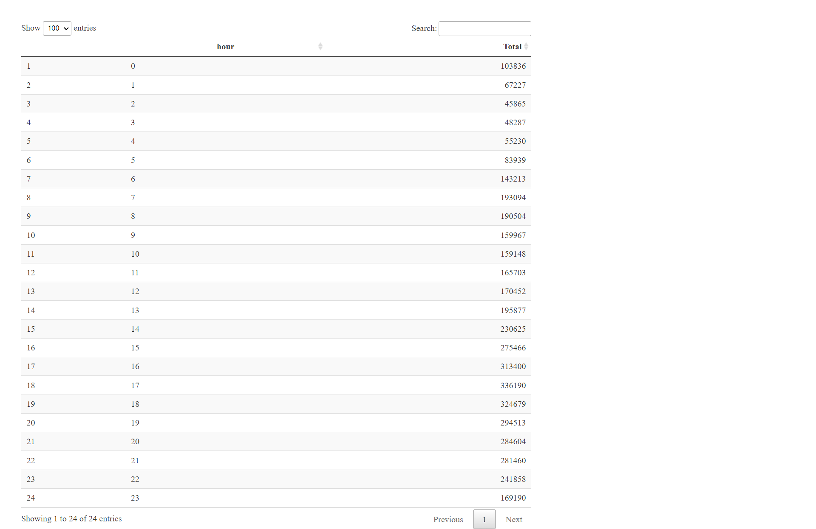
HOUR WISE TRIPS CALCULATION
Command :-
hour_data <- data_2014 %>%
group_by(hour) %>%
dplyr::summarize(Total = n())
datatable(hour_data)
Output :-

Slide 11
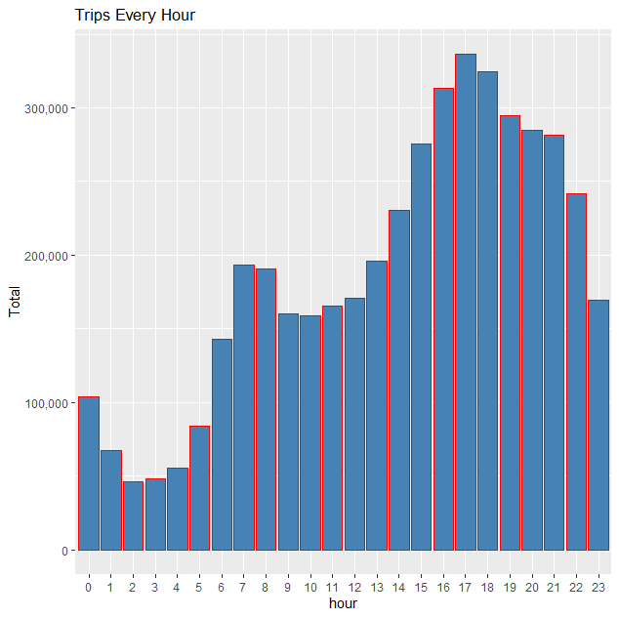
DATA VISUALIZATION
Bar Graph to show hour wise number of trips :-
ggplot(hour_data, aes(hour, Total)) +
geom_bar( stat = "identity", fill = "steelblue", color = "red") +
ggtitle("Trips Every Hour") +
theme(legend.position = "none") +
scale_y_continuous(labels = comma)
OUTPUT :-
So from above graph its clear that trips are maximum during
5PM-6PM. And minimum during 2 AM-3AM in New York city during month
April, May, June, July, August, September.

Slide 12
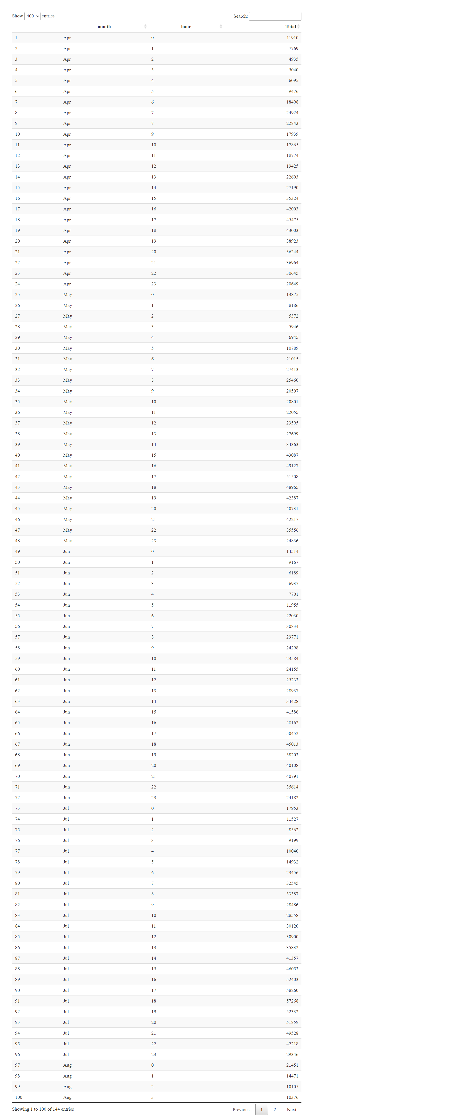
HOURWISE-MONTHWISE TRIPS CALCULATION
Command :-
month_hour <- data_2014 %>%
group_by(month, hour) %>%
dplyr::summarize(Total = n())
datatable(month_hour)
OUTPUT :-
This table shows the hour wise- month wise number of trips.

Slide 13
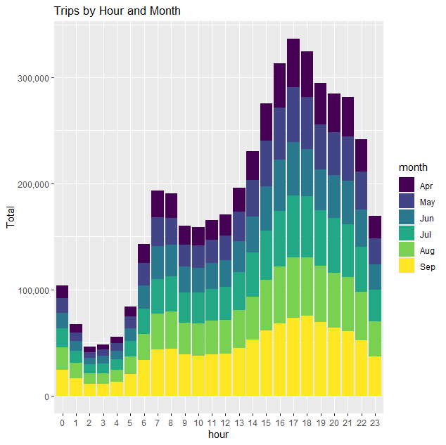
DATA VISUALIZATION
Command :-
ggplot(month_hour, aes(hour, Total, fill = month)) +
geom_bar( stat = "identity") +
ggtitle("Trips by Hour and Month") +
scale_y_continuous(labels = comma)
OUTPUT :-
This graph shows the months wise share among trips in specific
hours. Each and every color represent the each and every month as
represented in the index.

Slide 14
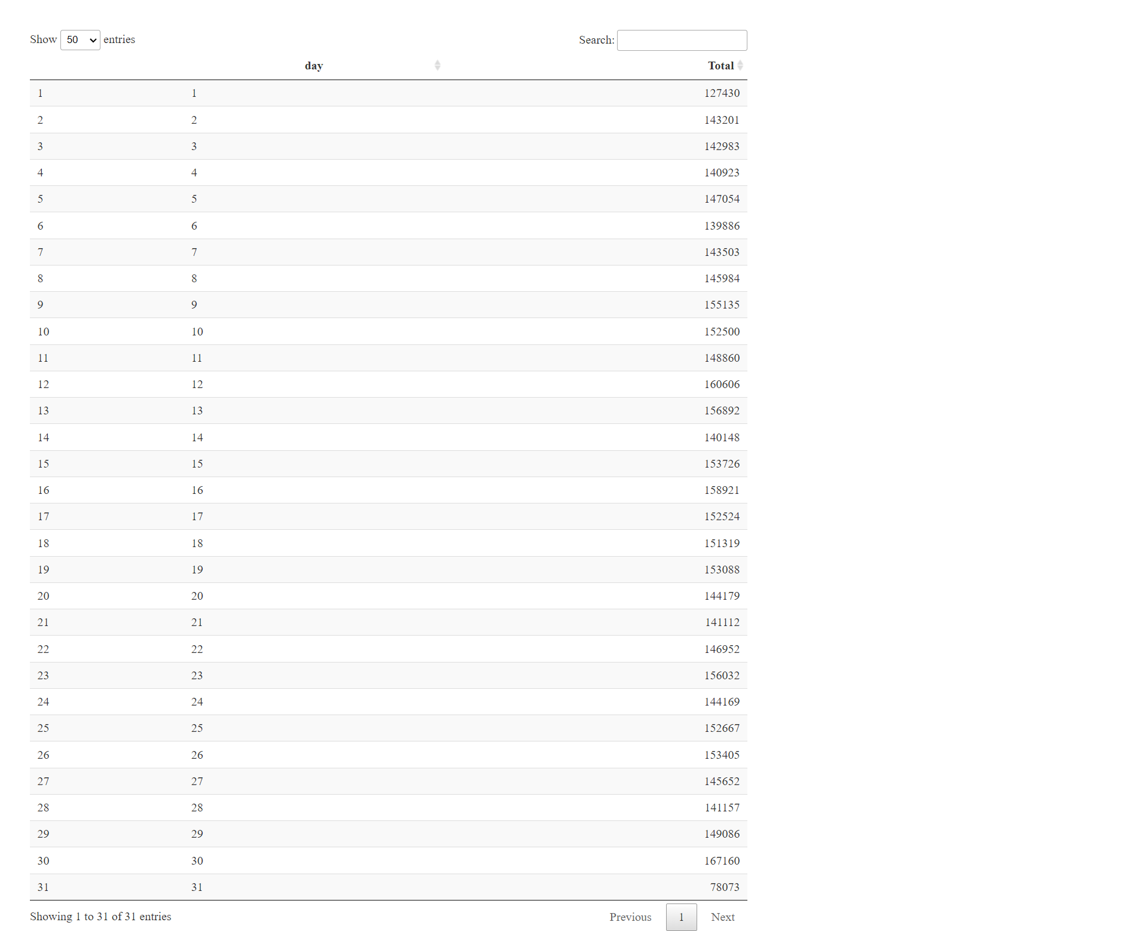
DAYWISE TRIP CALCULATION
Command :-
day_group <- data_2014 %>%
group_by(day) %>%
dplyr::summarize(Total = n())
datatable(day_group)
Output :-
This table shows the day wise number of trips including all
Six months.

Slide 15
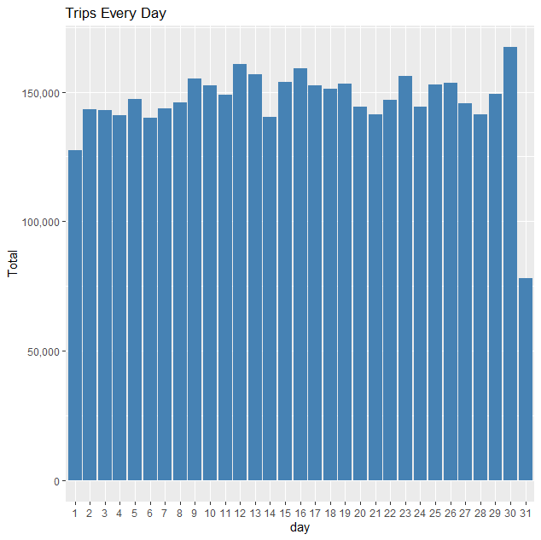
DATA VISUALIZATION
Command :-
ggplot(day_group, aes(day, Total)) +
geom_bar( stat = "identity", fill = "steelblue") +
ggtitle("Trips Every Day") +
theme(legend.position = "none") +
scale_y_continuous(labels = comma)
Output :-
We observe from the resulting visualization that 30th of the
month had the highest trips in the year which is mostly contributed
by the month of April. And lowest in 31st day but we can’t say it as lowest because
Every month does not contain 31 days.

Slide 16
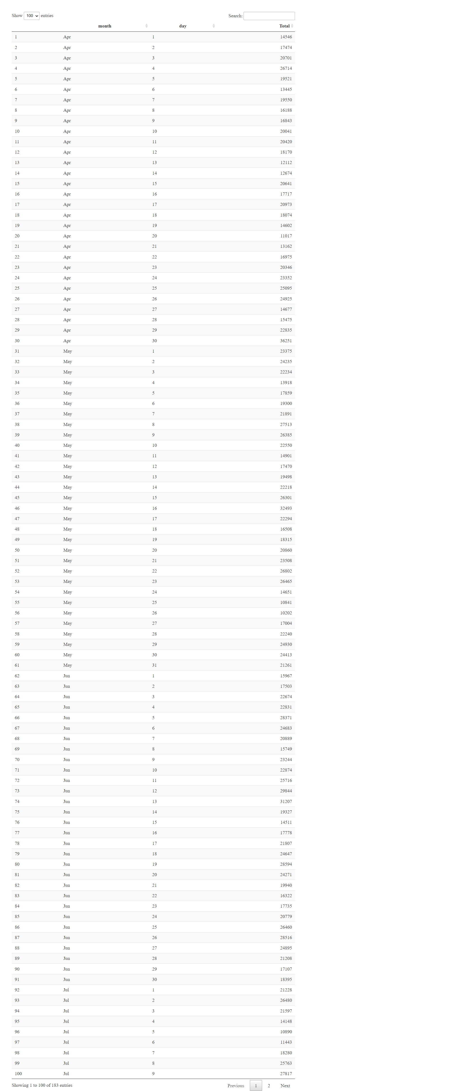
MONTHWISE-HOURWISE TRIPS
Command :-
day_month_group <- data_2014 %>%
group_by(month, day) %>%
dplyr::summarize(Total = n())
datatable(day_month_group)
Output :-
This table shows the month wise day wise number of trips.

Slide 17
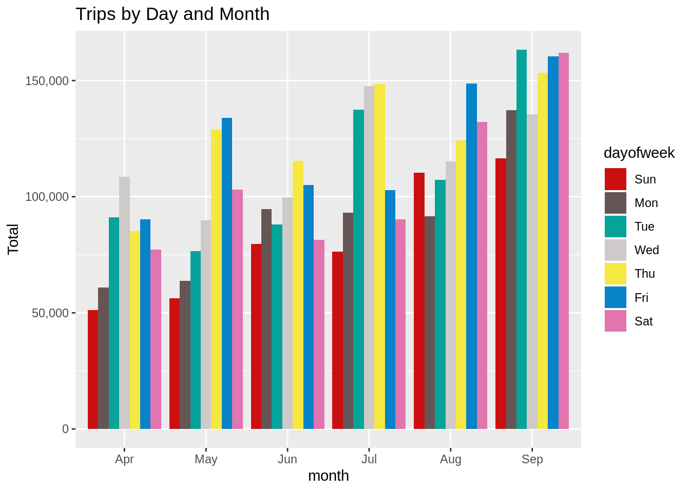
DATA VISUALIZATION
COMMAND :-
ggplot(month_weekday, aes(month, Total, fill = dayofweek)) +
geom_bar( stat = "identity", position = "dodge") +
ggtitle("Trips by Day and Month") +
scale_y_continuous(labels = comma) +
scale_fill_manual(values = colors)
OUTPUT :-
This graph basically shows the month wise-day wise number of trips. So
We can clearly conclude from above graph that in most of months Sunday has very lowest number of
trips . But only in August Monday has lowest number of trips. Incase of every month highest number
of trips changes as month changes. In April Wednesday got highest number of trips ,
where as in May and August Friday got highest number of trips. And in June-July on Thursday has highest
demand. But in September we can see Tuesday got highest number of trips.

Slide 18
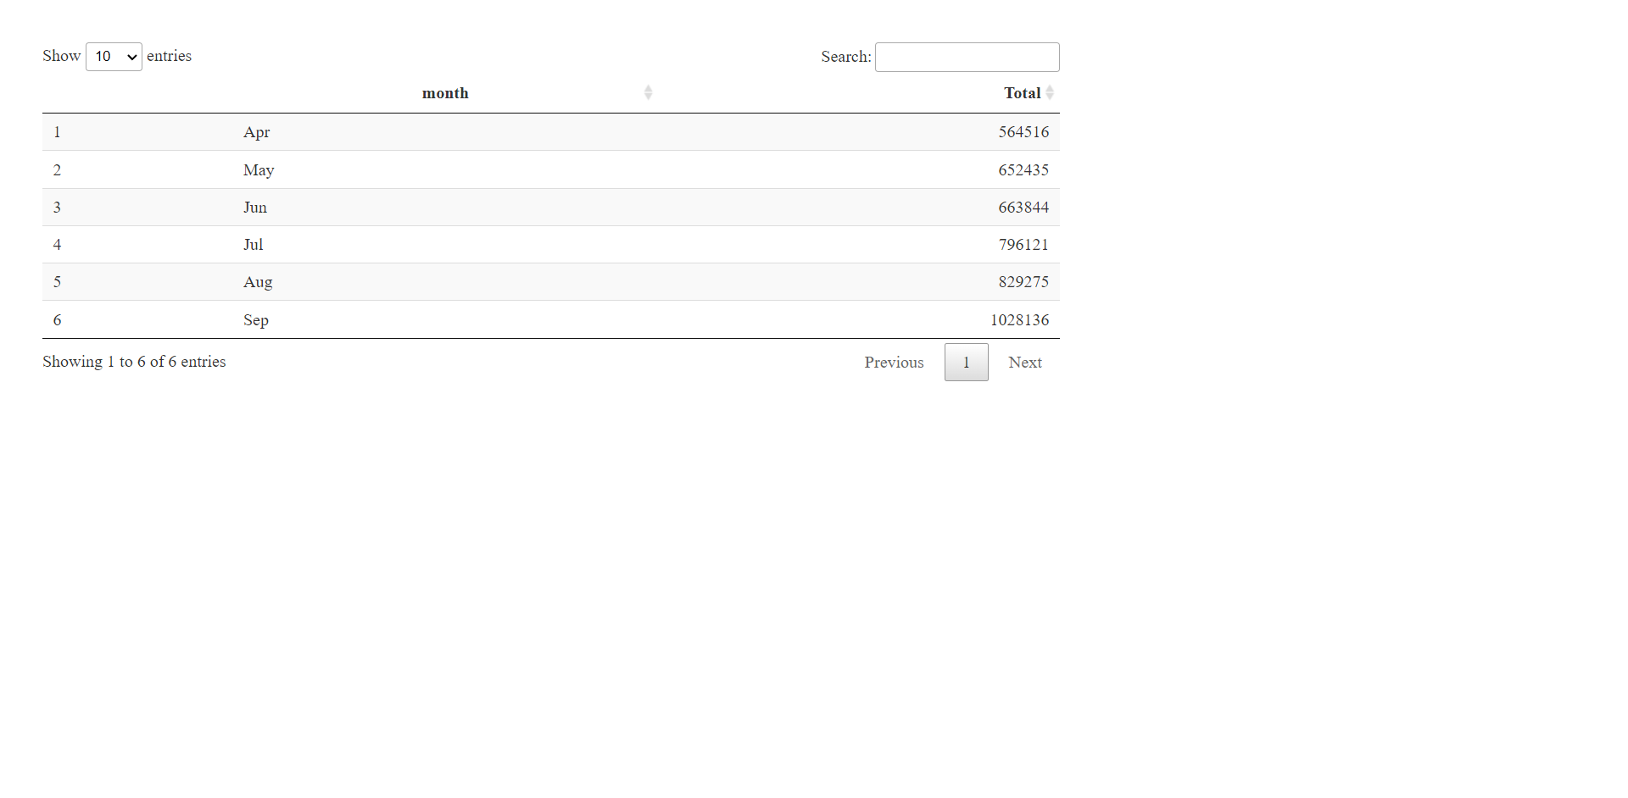
MONTHWISE TRIP CALCULATION
Command :-
month_group <- data_2014 %>%
group_by(month) %>%
dplyr::summarize(Total = n())
datatable(month_group)
OUTPUT :-
This is simple table which shows
Month wise number of trips.

Slide 19
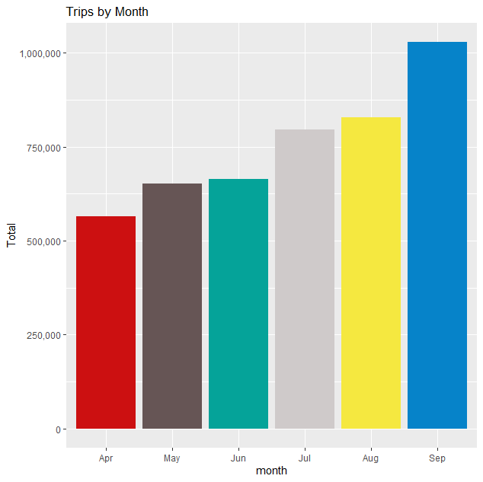
DATA VISUALIZATION
Command :-
ggplot(month_group , aes(month, Total, fill = month)) +
geom_bar( stat = "identity") +
ggtitle("Trips by Month") +
theme(legend.position = "none") +
scale_y_continuous(labels = comma) +
scale_fill_manual(values = colors)
OUTPUT :-
This is the basic bar graph which represents number of trips in each month. From
The graph its clear that in September Uber got most number of trips where as in April
Uber got least number of trips.

Slide 20
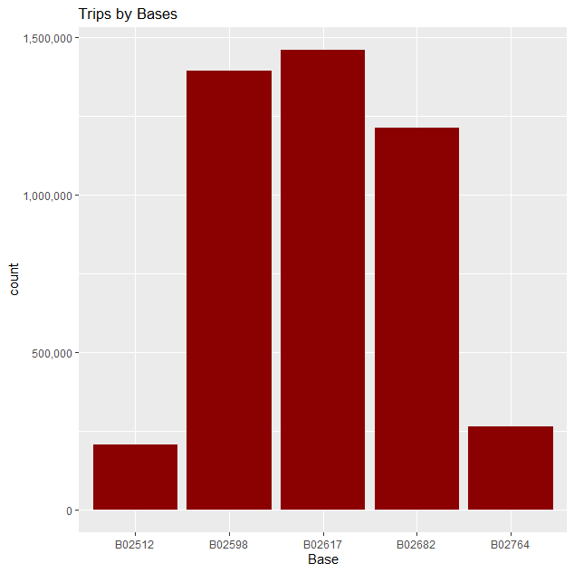
BASEWISE NUMBER OF TRIPS
Command :-
ggplot(data_2014, aes(Base)) +
geom_bar(fill = "darkred") +
scale_y_continuous(labels = comma) +
ggtitle("Trips by Bases")
Output :-
There are five bases in all out of which, we observe that
B02617 had the highest number of trips. And B02512 had lowest number of
trips. Its around 1,450,000 and 200,000 trips respectively.

Slide 21
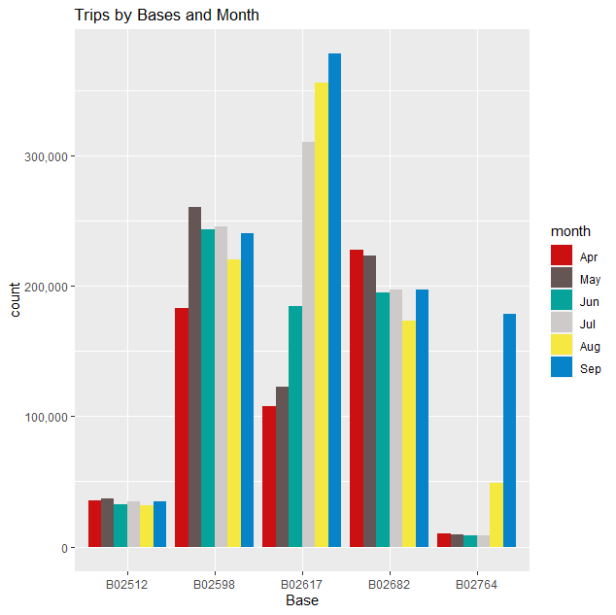
TRIPS BY BASES AND MONTHS
Commands :-
ggplot(data_2014, aes(Base, fill = month)) +
geom_bar(position = "dodge") +
scale_y_continuous(labels = comma) +
ggtitle("Trips by Bases and Month") +
scale_fill_manual(values = colors)
Output :-
So above graph clearly shows number of trips in different month from
different bases. So there was maximum trips from base B02617 in the
month of September. Where as minimum number of trips from base B02764
in the month of July. In most of the base we can see most number of trips in
month of September where as least number of trips changes randomly from month to
month.

Slide 22
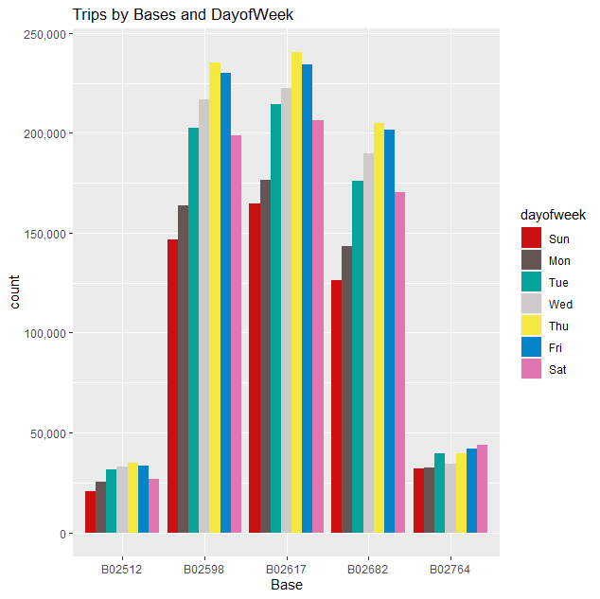
TRIPS BY BASES WEEKDAY WISE
Command :-
ggplot(data_2014, aes(Base, fill = dayofweek)) +
geom_bar(position = "dodge") +
scale_y_continuous(labels = comma) +
ggtitle("Trips by Bases and DayofWeek") +
scale_fill_manual(values = colors)
Output :-
Above graph represent number of trips from each base with respect to
week days. In general there is most number of trips from each base on
Thursday and lowest number of trips mostly in Sunday as it comes Holliday.

Slide 23
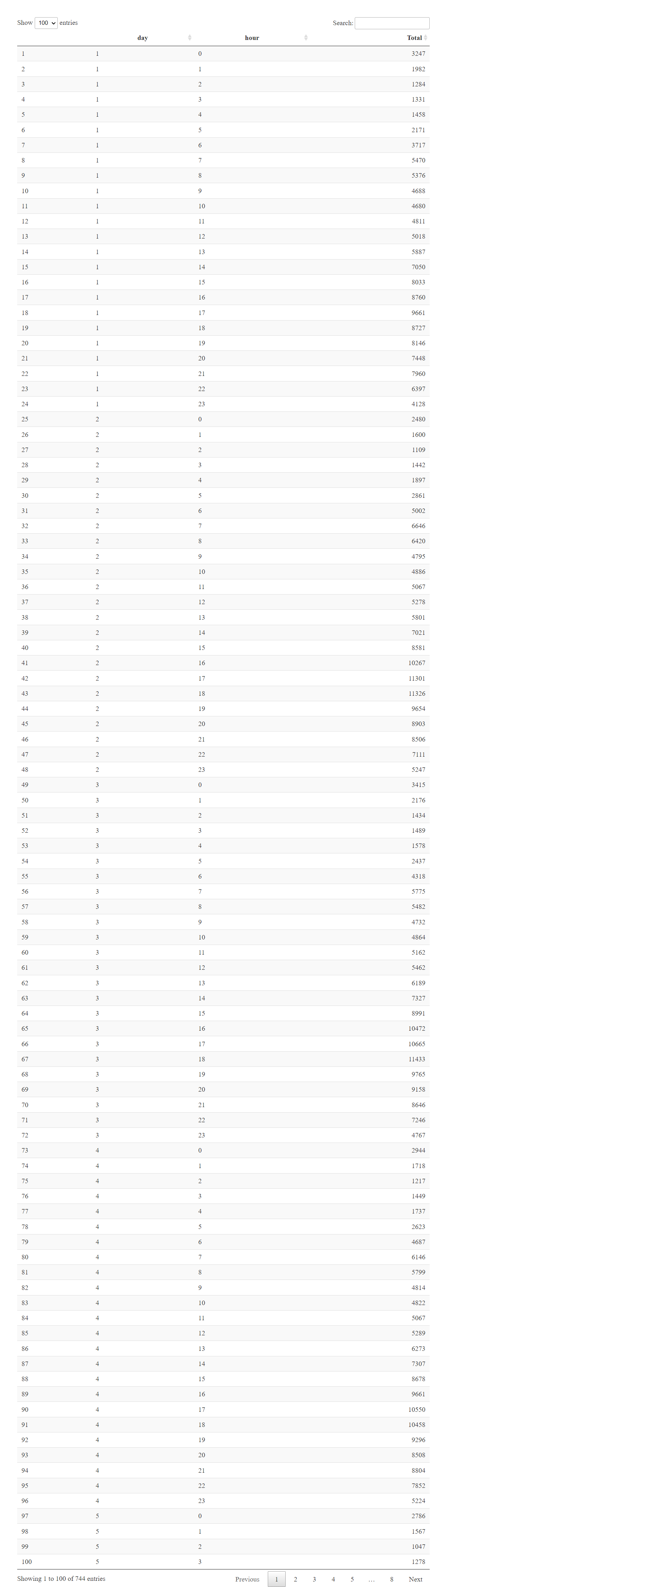
HOUR WISE NUMBER OF TRIPS IN EACH DAY
Command :-
day_and_hour <- data_2014 %>%
group_by(day, hour) %>%
dplyr::summarize(Total = n())
datatable(day_and_hour)
Output :-
This table basically represent hour wise number of trips in each and every day.
Let do some analysis on this table.

Slide 24
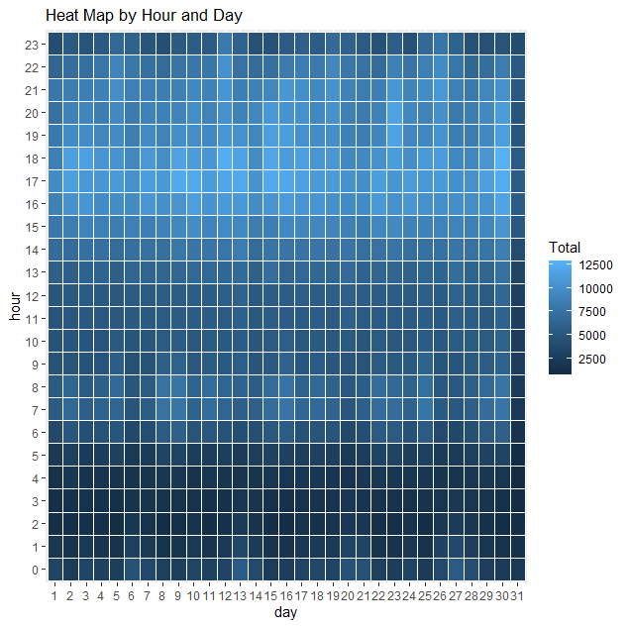
DATA VISUALIZATION
Command :-
ggplot(day_and_hour, aes(day, hour, fill = Total)) +
geom_tile(color = "white") +
ggtitle("Heat Map by Hour and Day")
Output :-
This heat map just shows relationship between hours and days in month.
We can clearly see from index that number of trips is very low during early morning
like 2AM-3AM.And we can also see number of trips are intense during evening
like 4PM-around 6PM.If we see day wise trips are some what intense on
30th day of month and lowest in 31st day of month. But we cant say lowest
because every month doesn't contain 31 days.

Slide 25
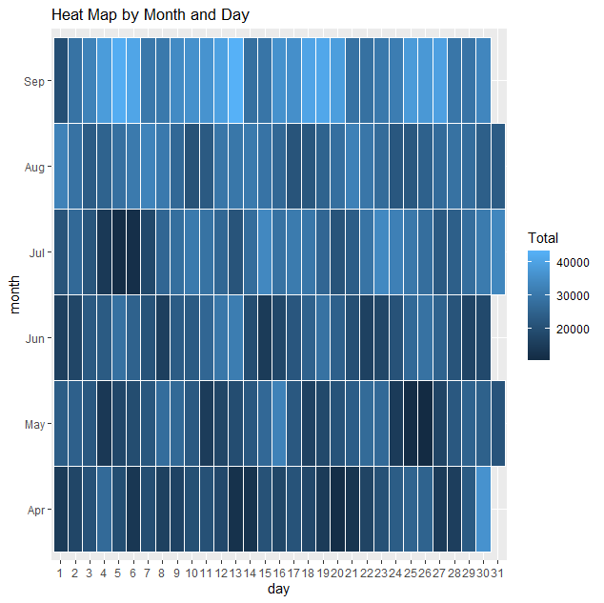
HEAT MAP BY HOURS AND DAYS
Command :-
ggplot(day_month_group, aes(day, month, fill = Total)) +
geom_tile(color = "white") +
ggtitle("Heat Map by Month and Day")
Output :-
From heat map its clear that September is most demanded month for the
Uber where as April is least demanded month. On the middle of each and every
month there is no such great demand for the trips. So from this data Uber can
keep exciting offers for customer attraction in middle of every month and make
more and more profit.

Slide 26
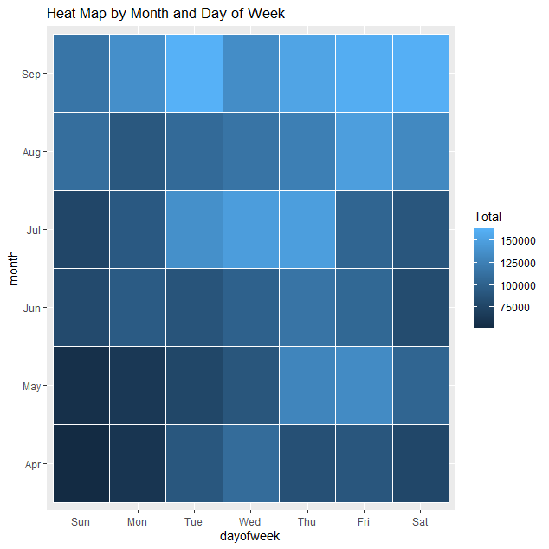
HEAT MAP BY MONTH AND DAY OF WEEK
Command :-
ggplot(month_weekday, aes(dayofweek, month, fill = Total)) +
geom_tile(color = "white") +
ggtitle("Heat Map by Month and Day of Week")
Output :-
This heat map clearly shows that Sundays of April month see
very less number of trips which is less than 75000 trips overall.
In the same way Saturdays of September is maximum number
of trips its more than 150000 trips. And middle week days of July
also saw some peak in demand but thing we should note is
that there is less demand for Uber in starting of every month.

Slide 27
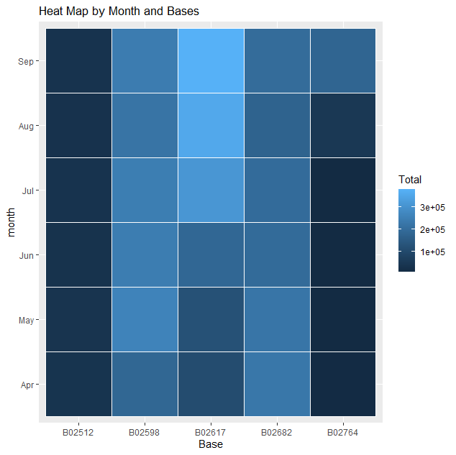
HEAT MAP BY MONTH WITH RESPECT TO BASE
Command :- Output :-
month_base <- data_2014 %>% From heat map its clear that base B02512 and B02764 is bases
group_by(Base, month) %>% with least number of trips and B02598 and B02617 are the bases
dplyr::summarize(Total = n()) with most number of trips. And again its clear that September is
day0fweek_bases <- data_2014 %>% peak season and April is month with least number of trips for
group_by(Base, dayofweek) %>% each base.
dplyr::summarize(Total = n())
ggplot(month_base, aes(Base, month, fill = Total)) +
geom_tile(color = "white") +
ggtitle("Heat Map by Month and Bases")

Slide 28
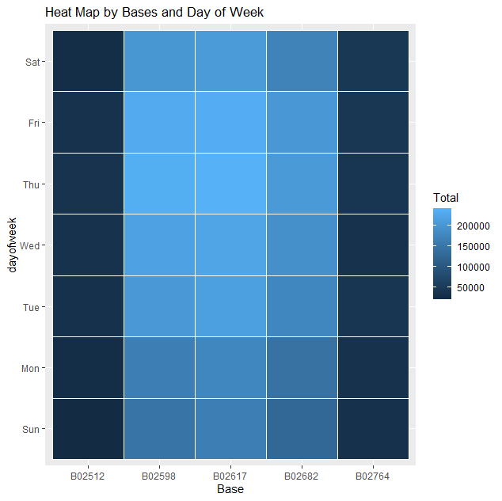
HEAT MAP BY BASE AND DAYS OF WEEK
Command :-
ggplot(day0fweek_bases, aes(Base, dayofweek, fill = Total)) +
geom_tile(color = "white") +
ggtitle("Heat Map by Bases and Day of Week")
Output :-
From this heat map its crystal clear that Base B02512 and B02764 is the base
with least number of trips where as B02617 is base with most number of trips.
And its also clear that Sunday has least demand among week days and
Thursday and well as Friday have most demand for Uber trips.

Slide 29
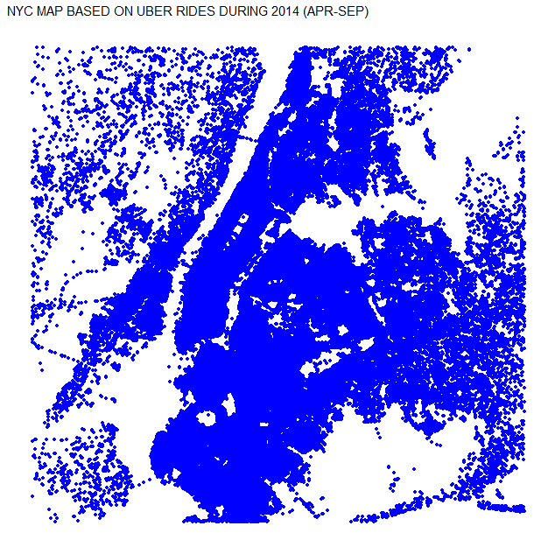
CITY MAP BASED UBER RIDES
Command :-
min_lat <- 40.5774
max_lat <- 40.9176
min_long <- -74.15
max_long <- -73.7004
ggplot(data_2014, aes(x=Lon, y=Lat)) +
geom_point(size=1, color = "blue") +
scale_x_continuous(limits=c(min_long, max_long)) +
scale_y_continuous(limits=c(min_lat, max_lat)) +
theme_map() +
ggtitle("NYC MAP BASED ON UBER RIDES DURING 2014 (APR-SEP)")
Output :-
This is trip based New York City map. Each dot represents each trip and we can clearly
see that middle of city has most number of trips. And out skirt of the city has less number
of trips.

Slide 30
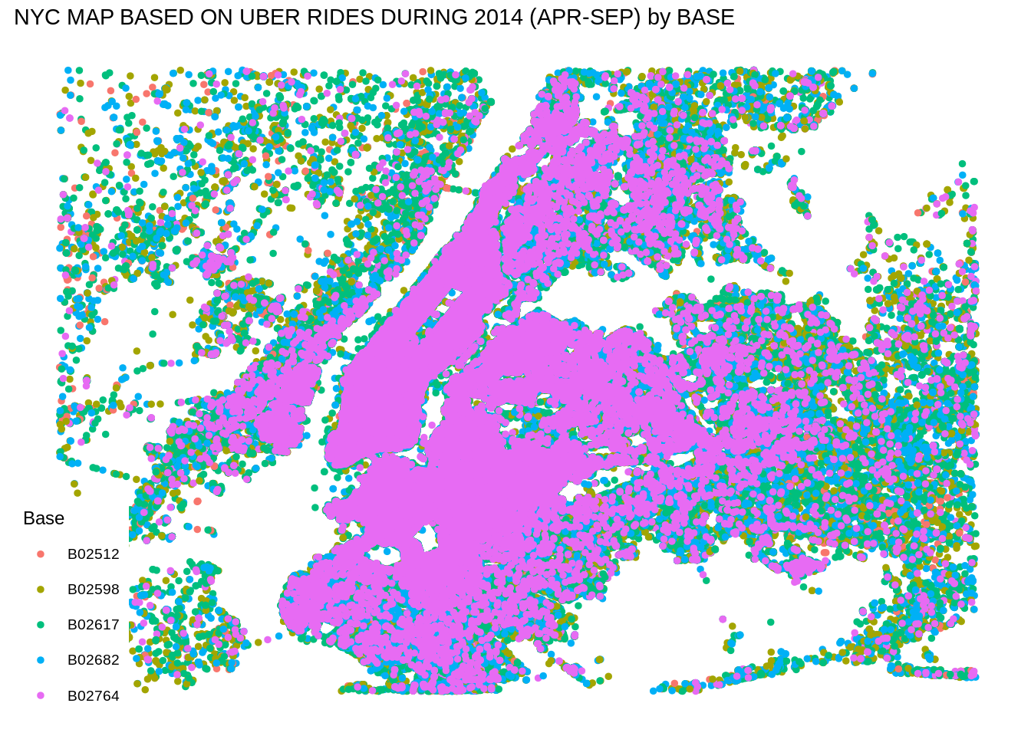
CITY MAP BASED ON UBER RIDES WITH RESPECT TO BASE
Command :-
ggplot(data_2014, aes(x=Lon, y=Lat, color = Base)) +
geom_point(size=1) +
scale_x_continuous(limits=c(min_long, max_long)) +
scale_y_continuous(limits=c(min_lat, max_lat)) +
theme_map() +
ggtitle("NYC MAP BASED ON UBER RIDES DURING 2014 (APR-SEP) by BASE")
Output :-
This is the City map of trips with respect to base. Different color represent different bases as
given in index. So basically trips are dense in middle part of city . And as we interpreted less in
outer part of city.

Slide 31
SUMMARY
At the end of the Uber data analysis this project, we observed how to create data visualizations and interpreted so many conclusions through heat map, bar graph and city map . We made use of packages like ggplot2 that allowed us to plot various types of visualizations that pertained to several time-frames of the year. With this, we could conclude how time affected customer trips. Finally, we made a geo plot of New York that provided us with the details of how various users made trips from different bases.

Slide 32
REFERENCES
https://www.kaggle.com/
https://drive.google.com/file/d/1emopjfEkTt59jJoBH9L9bSdmlDC4AR87/view
REFERENCE NOTES

Slide 33
THANK YOU

